Slide 1
Design Patterns : Tailor-made Solutions for Software Development
View Design Patterns course details at www.edureka.co/design-patterns
For Queries:
Post on Twitter @edurekaIN: #askEdureka
Post on Facebook /edurekaIN
For more details please contact us:
US : 1800 275 9730 (toll free)
INDIA : +91 88808 62004
Email us : sales@edureka.co

Slide 2
Objectives
At the end of this session, you will be able to:
Understand need of Design Patterns
Build flexible Design using Design Patterns
Design UML Diagrams
Code with AbstractFactory Pattern
Use Observer Pattern & Mediator Pattern

Slide 3
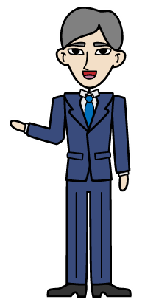
Let’s Find a Pattern?
1 , 3, 5, __ , 9…..
B , D, H, __

Slide 4
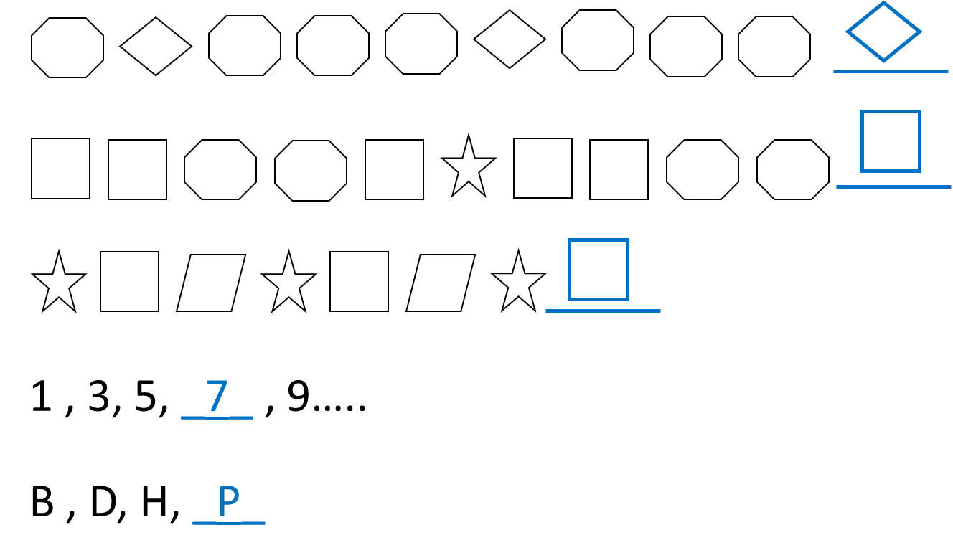

We Found a Pattern !!
Patterns are easy to recognize and they are everywhere and the beautiful thing is that we come across them every day.
Patterns are recurring solution to a standard problem

Slide 5
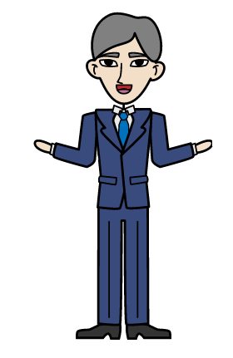
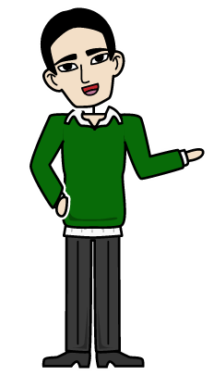
Software Development Programming Problems
What about software Development Programming Problems? Do we have a patterns for these also?
Yes. Design Patterns are recipes against common programming problems, so you don’t have to reinvent the wheel again.

Slide 6
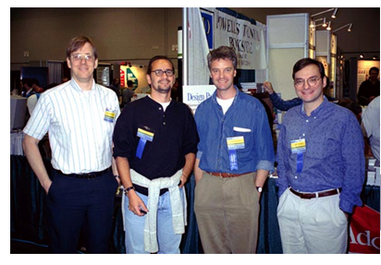
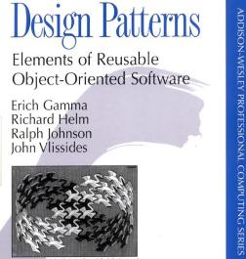
Software Design Patterns
Software design patterns describe classes and interacting objects used to solve a general and repeatable design problems in a specific context with proven solution
This is the most popular book written on Software Design Patterns by Erich Gamma, Richard Helm, Ralph Johnson and John Vlissides, known as Gang Of Four

Slide 7
Importance of Design Patterns
You can visualize the prevalence of Design Patterns, as most of the current software applications are being developed using OOP paradigm
As most of the Design Patterns are proved around OOP paradigms, most of the programmers think that both are related
Design Patterns have nothing to do with Object Oriented Programming
It is a tried and proven solution to commonly occurring programming problem

Slide 8
Use Case
Problem Statement
Consider an example of distributed system like Cement Factory, Pickle Factory or Cheese Factory where a raw material has to go through different processes
In each process the material is processed under automated machines which keeps track of temperature, flow-speed, ingredients of mixture
Data is captured using sensors and passed to Master control system
These machines operate in coordination, suppose if temperature of the mixture is less than required then, Master control system will automatically send the increase temperature command to machine
So how can we build such an automated system ?

Slide 9
Use Case (Contd.)
Requirements
There are different entities monitoring the data generated by these sensors
Each entity takes its own decision on data and informs others as well at times
There is a master management control room from where commands to different entities may generate
Data from entities should also report back to master management control room

Slide 10
General Depiction
Packaging Entity
Chemical Control
Entity
Master Management Control System
Catalyst Control Entity
Actuator
Sensors

Slide 11
Procedural Program Pitfalls
Procedural Programmer would put all the functionality pertaining to Master management control system into main function and the subsequent individual entity functions would go to subroutines
Challenge is procedural paradigm revolve around the functionality rather than data
This has to be replaced with Object Oriented paradigm to be adaptable to change
Does Object Oriented Programming solve all the problem ?
Main
Procedure A
Procedure B
Procedure X
Procedure Y
Procedure Z
Procedural Programming

Slide 12
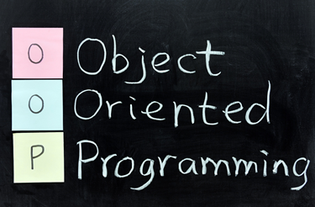
OOP Implementation…
Practicing Object Oriented Programming merely doesn’t solve all the problems
An OOP programmer will take Master Management Control unit as one object and subsequent individual entities as different objects, while sensors and actuators as further different objects
And then our design revolves around designing communication channels among these and make them interact to achieve the goal

Slide 13
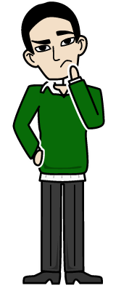
Something is Missing …
It looks good that we have achieved a perfect OOP model
What if I would like to increase my factory or application capacity?
What if I need to modify the making process in line with new research results?
What if I would like to add new features involving same software elements ?( in the case of any software application).

Slide 14
Build it with Design Patterns
The model of this particular manufacturing entity without using design pattern may work at one time, but it would definitely pose scalability issues in the future
Such kind of designs will hinder the growth. That’s where Design Patterns come into the picture
While building an application its important that we keep the future requirements and changes in mind otherwise you will have to change the code that you had written earlier
Building a large application is never easy, so its very important that you design it correctly and then start coding the application
Design Patterns provides efficient techniques to create a flexible application design

Slide 15
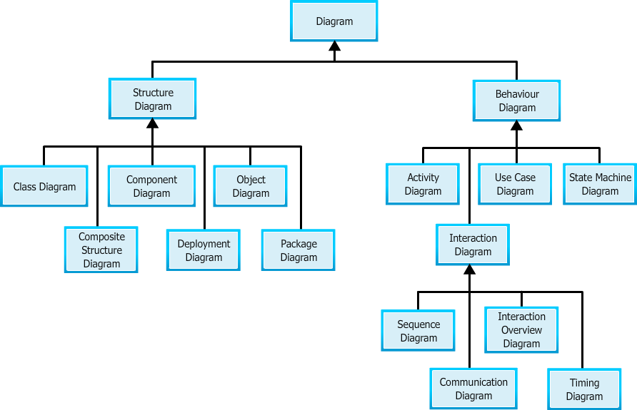
UML – Designs Made Easy
UML is a modelling language widely used to visualize the object oriented designs
UML makes it easy to visualize the software design
UML diagrams can be easily decoded and converted into most of the popular object oriented programing languages

Slide 16
UML Tools
UML was created and developed by Grady Booch at Rational Software which was later acquired by IBM. While IBM have their proprietary tool called Rational Rhapsody, we do have lot of other popular open source tools as well
AgroUML, Dia UMLet, StarUML are some of the free open source UML tools with a simple user interface. They enable to create fast diagrams
Apart from that, there is a plug-in available for Eclipse as well
Another well known enterprise modelling software includes Microsoft Visual Studio.NET Enterprise Architect, MagicDraw, IBM Rational

Slide 17
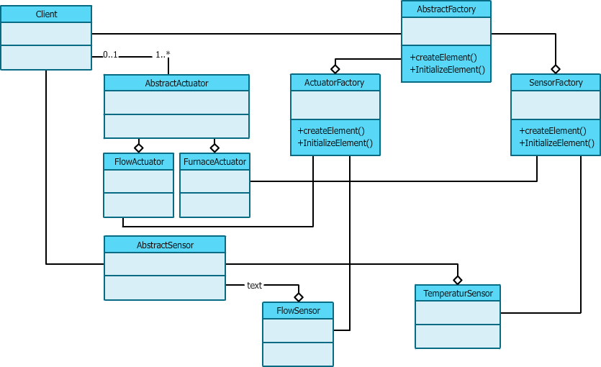
Abstract Factory Illustration

Slide 18
Observer Pattern
Observer:
There is someone watching you
Observer
Observes
Subject
notify

Slide 19
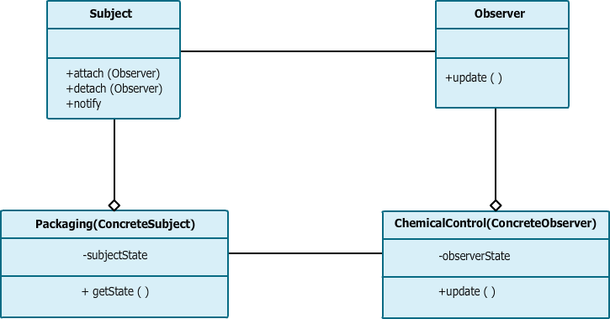
Observer Pattern

Slide 20
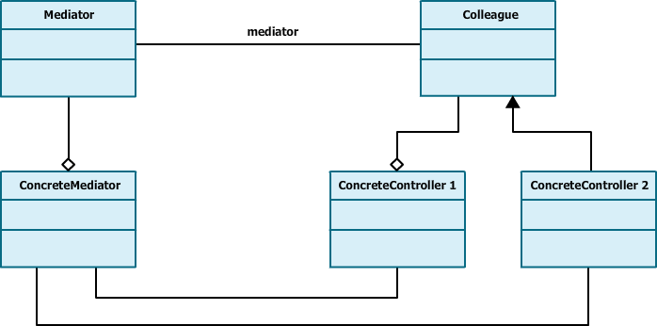
Mediator Pattern
It is not advisable to have multiple communication channels open between multiple control entities
It is neither good for debugging nor maintaining
Mediator pattern comes as a boon in this case

Slide 21
Conclusion
Similarly there are other design patterns to solve majority of the problems that software designers encounter during their day to day activities
Design patterns compliments ones experience and helps them deliver wonderful and successful software designs
They serve as common nomenclature or jargon that architects can easily communicate with others in software industry
Software design is no more an art. It’s a skill one can learn. And thanks to design patterns

Slide 22
Course Topics
Module 5
Concurrency Design Patterns
Module 6
Anti Patterns
Module 7
Refactoring
Module 8
Project and Retrospection
Module 1
Introduction to Design Patterns
Module 2
Creational Design Patterns
Module 3
Structural Design Patterns
Module 4
Behavioral Patterns

Slide 23
How it Works?

